Slide 1


AI FINANCE AUTO-RESPONSE FOR RECEIPT REQUESTS
Hell Fire team

Slide 2

ABOUT OUR PROJECT
Our project is an AI-based finance system that automatically responds to student receipt requests, removing repetitive manual work from finance offices.

Slide 3

THE PROBLEM
We chose this problem based on our own university experience. After every online payment, students must email the finance team to request a receipt and often wait a long time for a response. Realizing that thousands of similar requests are sent every day, we saw how much time this process wastes for both students and finance staff. This motivated us to design an automated solution to streamline receipt requests and responses.

Slide 4

OUR SOLUTION
  Our AI solution automatically handles student receipt requests by reading incoming messages, identifying receipt-related requests, and extracting the student ID. It then matches the request with payment records and sends a clear, professional response. This automation ensures fast and accurate receipt confirmations while reducing manual work for finance staff.

Slide 5
FINANCE AND MARKET
Market Opportunity
With 235M+ students and 26,000+ universities worldwide, every institution processes receipt confirmations. The global higher-education market is worth $2.7T, making automation highly scalable.
Time & Cost Savings
A manual receipt reply takes ~5 minutes. For 5,000 requests, this saves 417 staff hours (~$12,500). At 20,000 requests/year, universities save ~1,670 hours or ~$50,000 annually.
Infrastructure Advantage
Traditional systems cost $24,000+/year. A serverless AWS setup costs just $36–$360/year, delivering up to 99% cost reduction.
ROI per University
With total annual costs of about $4,000, universities gain over $45,000 in net value per year through staff time and infrastructure savings.

Slide 6
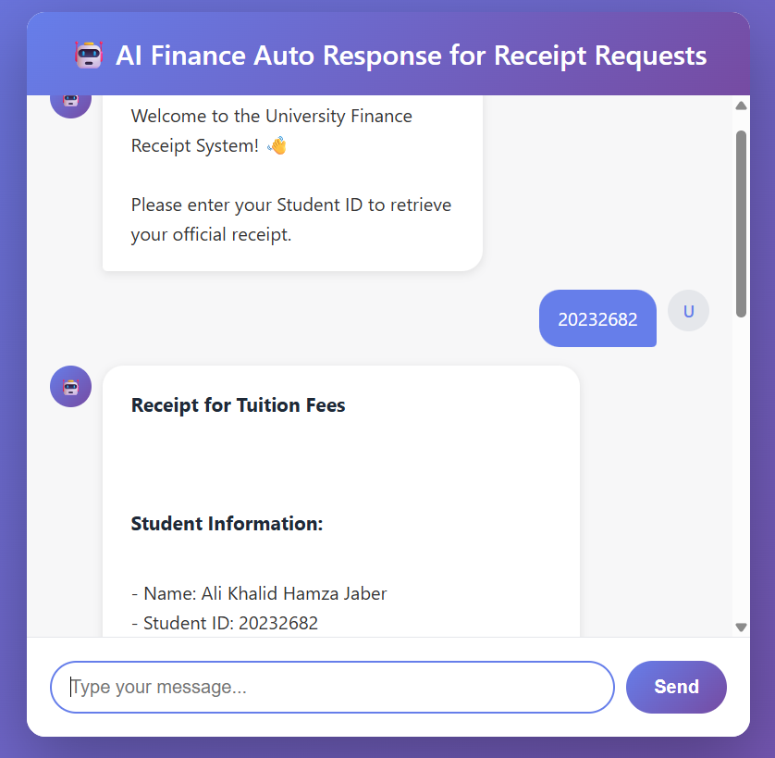
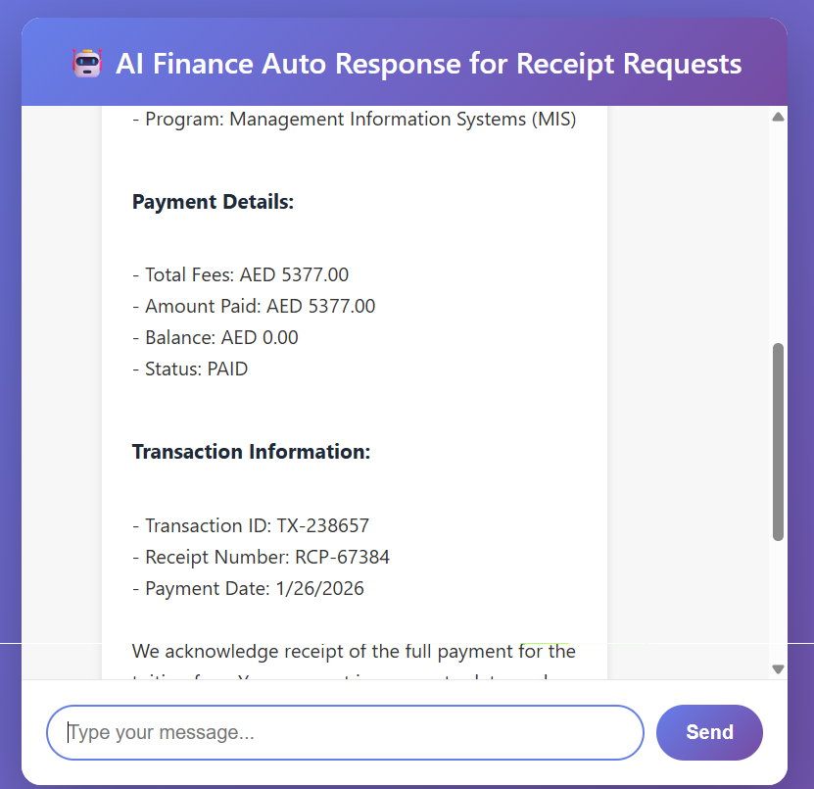
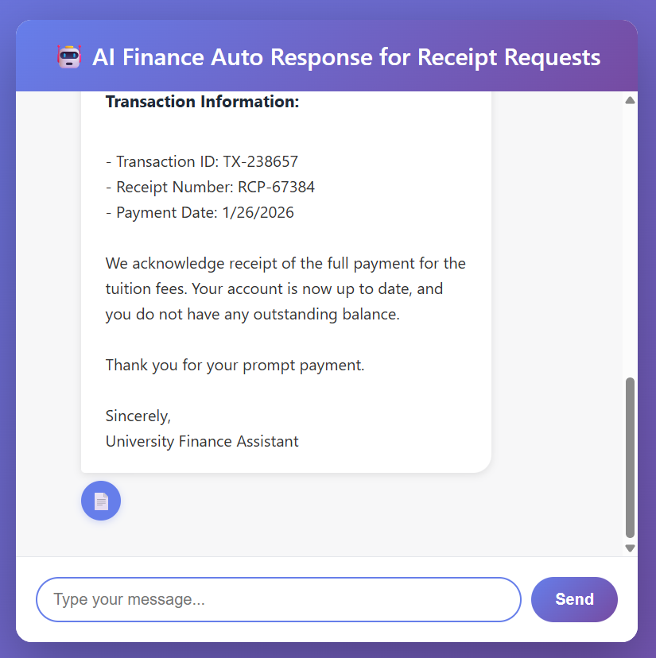
EXAMPLE AUTO-RESPONSE
Download Receipt Button

Slide 7
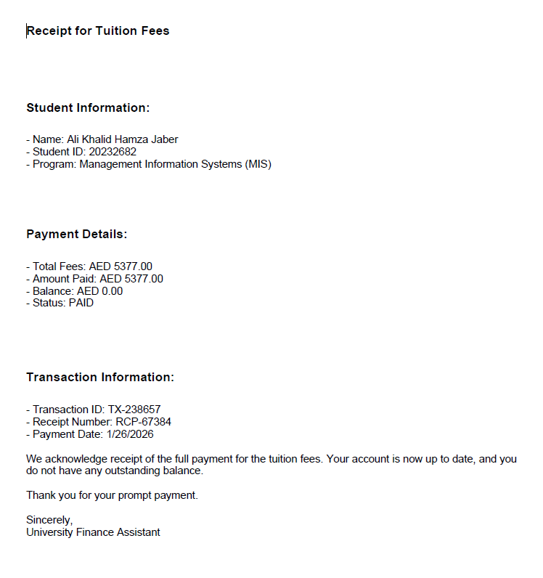
EXAMPLE AUTO-RESPONSE

Slide 8
THANK YOU!
HELL FIRE TEAM
Khalid Eyad
Leen Albadda
Mohammed Abdallah

